Slide 1

Determining the number of factors in approximate factor models by twice K-fold cross validation
Jie Wei, Hui Chen
School of Economics, Huazhong University of Science and Technology, China
Economics Letters
Volume 191, June 2020, 109149
Summarized by Nicholai L’Esperance

Slide 2
Problem Statement
“A critical step in the analysis of factor models is to determine the number of factors, which is needed in implementation of estimation and forecasting algorithms.”
The researchers are attempting to identify the number of “latent factors” hidden within a dataset.

Slide 3
Definitions
True/Latent Factor: An un-observable independent variable. Observed variables are modeled as a function of some number of these latent variables.
Idiosyncrasies: In econometrics, these are factors unique to an individual investment, rather than the market as a whole. In essence, idiosyncrasies are similar to noise.

Slide 4
Data
The researchers’ dataset contains observations of N units across T time periods.
Some unknown number of latent features, R⁰, have impacts on the market as a whole. This is what we want to uncover.
Idiosyncrasies can have both correlations across units and over time. These are what the researchers want to avoid modeling.

Slide 5
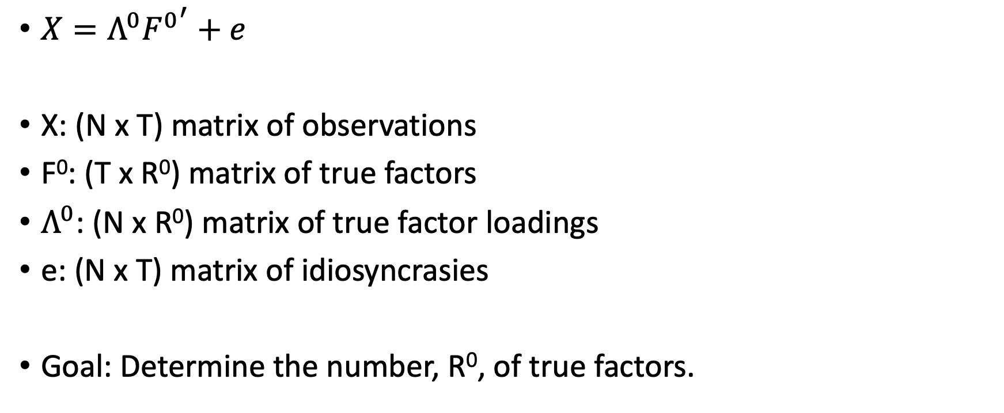
Data Model
$X=Λ^{0}{F^{0}}^{′}+e$
X: (N x T) matrix of observations
F⁰: (T x R⁰) matrix of true factors
$Λ^{0}$: (N x R⁰) matrix of true factor loadings
e: (N x T) matrix of idiosyncrasies
Goal: Determine the number, R⁰, of true factors.

Slide 6
Proposed Approach
Perform k-fold cross validation in two dimensions (across units N, and then across time T), estimating the number of true factors.
J-fold CV in N dimension, and estimate the the factors (F⁰)
K-fold CV on the holdout data in T dimension, estimating factor weights (Λ⁰).
Repeat this process for every combination of chunk J and K.

Slide 7
Simulated Validation Setup
To test the estimator’s efficacy, the researchers created eight “Data Generation Processes”. Each of the eight data generators represent different levels and distributions of idiosyncrasies. R⁰ is set to 5.
For each of the generators, the researchers test their approach on multiple different dataset sizes, and compare their results to several other true factor estimators.
Each experiment is run 2000 times, and the MSE is averages across all runs.

Slide 8
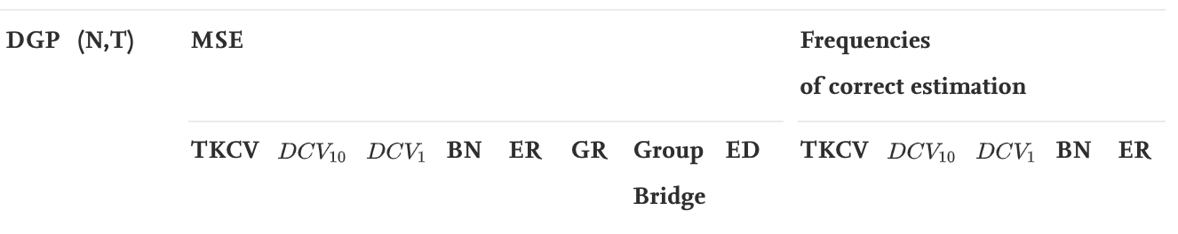
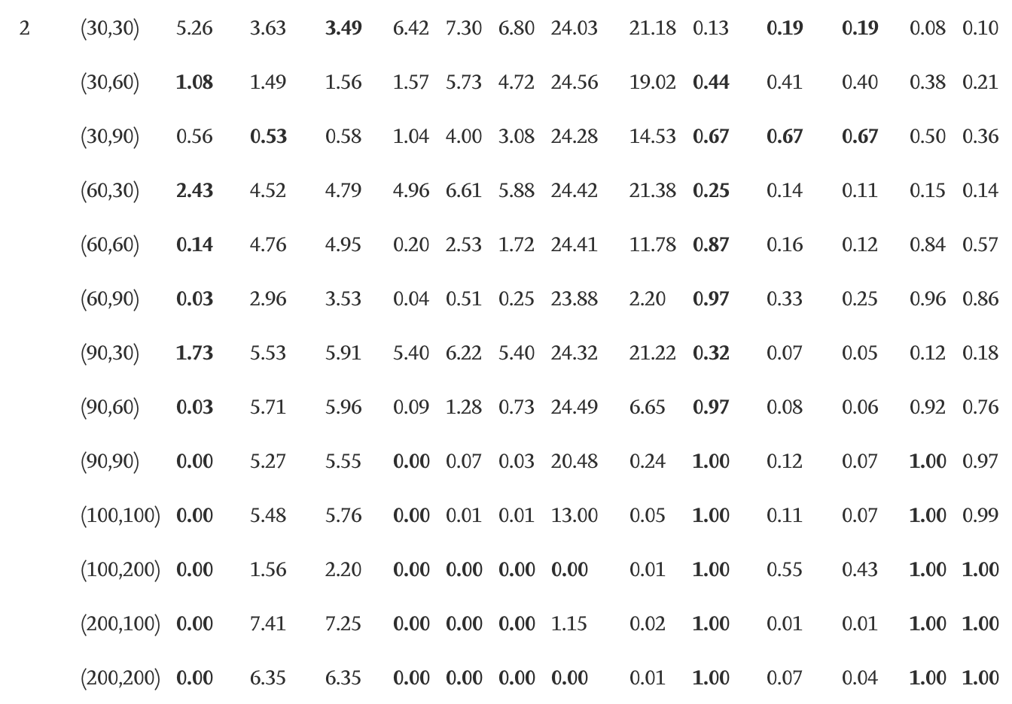
Data Generator 2
Size of matrix X
Strong performance across the board.
High MSE

Slide 9
Simulation Results
In two of the five generated data sets, an alternate method “DCV” had superior results to the researchers’ “Twice K-Fold Cross Validation” (TKCV) method. However, these two datasets did not include additional idiosyncrasy correlations.
In datasets with higher idiosyncratic correlation, TKCV performed better overall, noting very high MSE in several of the alternative methodologies.
Overall, TKCV appeared to be the most robust and accurate method, especially in datasets resembling more realistic economic data.

Slide 10
Testing TKCV Empirically
TKCV is applied to real quarterly economic data from the UK, between 1997 and 1999.
Seven additional methods are tested in comparison.

Slide 11
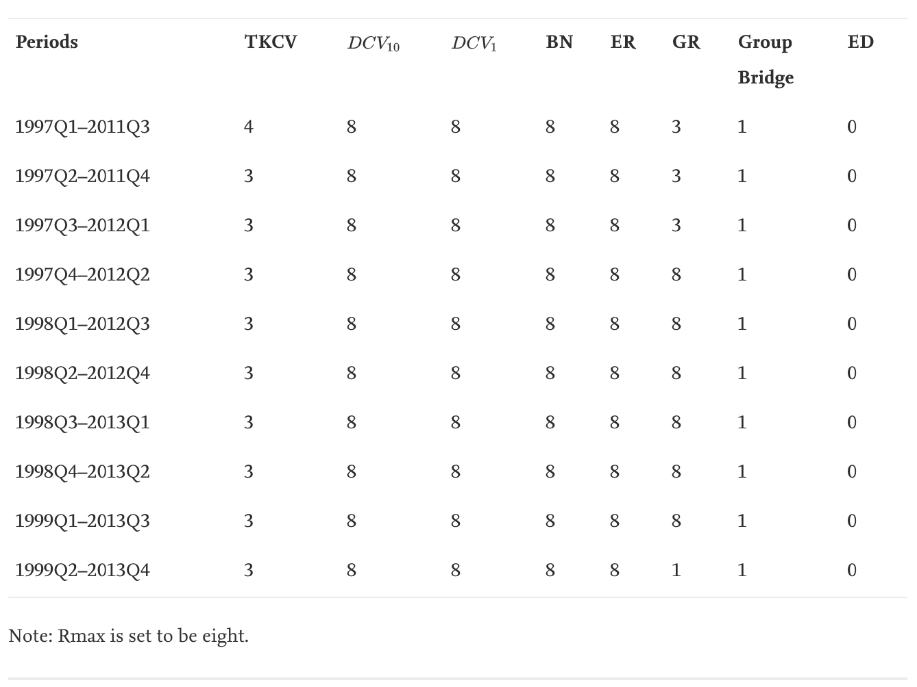
Empirical Results
Estimates of 0/1 are assumed erroneous, based on apriori knowledge of economics.
Estimates of 8 are also likely erroneous, as they simply equal the maximum value set in the model.
Comparing TKCV and GR, the researchers believe there exist three major latent factors influencing the UK economy between 1997 and 1999.

Slide 12
Conclusions
The researchers TKCV technique performed very well compared other state-of-the-art techniques.
It did not outperform other methodologies with every data distribution/size, but performed the best overall.
Empirically, the TKCV technique outperformed every other methodology in identifying the true number of latent factors.

